Slide 1


AZERPROPERTY
Azerproperty
Team name - adawnik
Mubariz, Ceyhun, Imran, Raul

Slide 2




TECH STACK

Slide 3
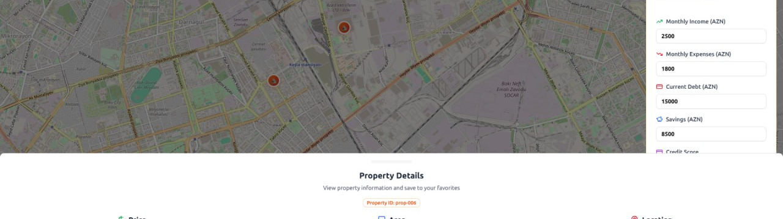
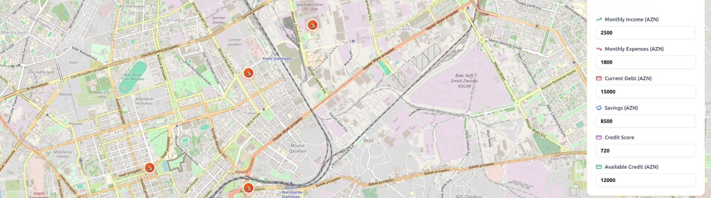

Slide 4
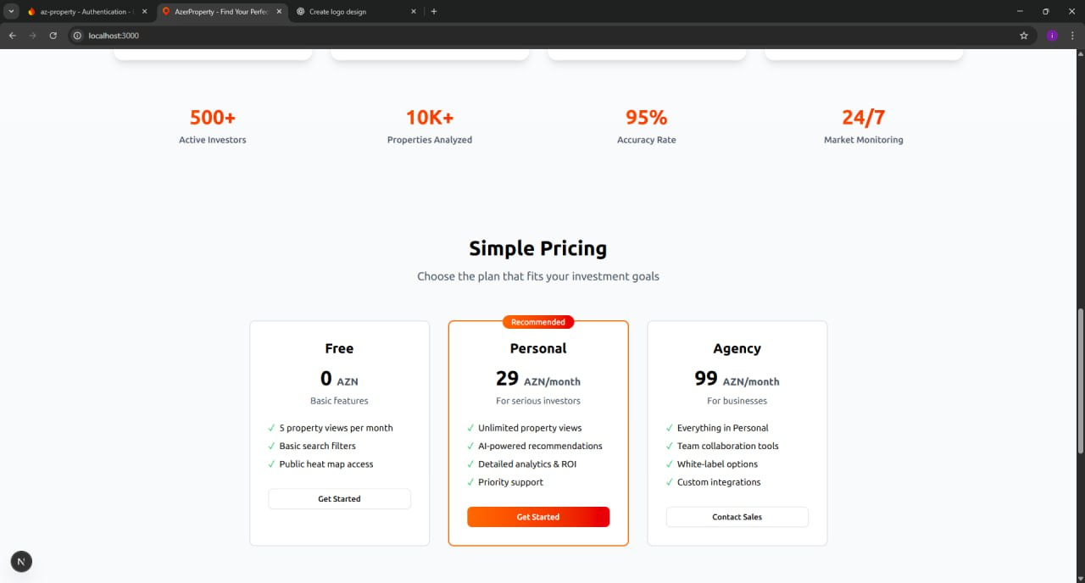
Pricing

Slide 5

Thanks for your attention!
AZERPROPERTY

